Slide 1
PRINCIPLES OF AUTONOMY AND DECENTRALIZATION OF STATE BODIES
MIROSLAVA VOZÁRYOVÁ
COMENIUS UNIVERSITY, BRATISLAVA, MFA SR

Slide 2
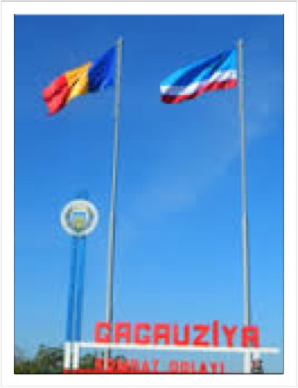
DEFINITION
An autonomous administrative division (also referred to as an autonomous area, entity, unit, region, subdivision or territory) is a subdivision or dependent territory of a country that has a degree of self-governance, or autonomy, from an external authority.

Slide 3

DEFINITION
Typically, it is either geographically distinct from the rest of the country or populated by a national minority.
Decentralization of self-governing powers and functions to such divisions is a way for a national government to try to increase democratic participation or administrative efficiency and/or to defuse internal conflicts.

Slide 4
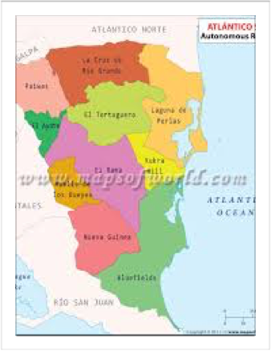
AUTONOMOUS REGIONS AROUND THE WORLD
17 AUTONOMOUS COMMUNITIES IN SPAIN
117 AUTONOMOUS COUNTIES IN CHINA
8 AUTONOMOUS DISTRICT COUNCILS IN INDIA
6 AUTONOMOUS OKRUGS IN RUSSIA

Slide 5
WHAT AUTONOMY IS?
Autonomy implies that the region has true political power which, also lesser than that of sovereignty, is greater than that of administrative decentralisation
Autonomy is limited and derived power, non-originary, coming from a Constitution which defines it in precise terms and which for this reason has to be a written and rigid one, which can not be freely changed by the central Parliament

Slide 6
WHAT AUTONOMY IS?
The regional power exercises real governing functions, although limited, and is not hierarchically subordinated to the central Government
The regional parliament has also legislative powers and is not subordinated to the central parliament
the fullest sense autonomy exists in Italy, Portugal and Spain

Slide 7

COEXISTENCE WITHIN THE STATE
the autonomous region as a Peace Building Mechanism
Notes on Devolution and Decentralisation based on Jurisprudence of Autonomous Regions
Intergovernmental Relations

Slide 8
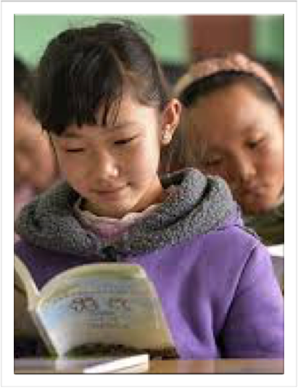
Autonomous regions in reality
Constitutions vs real life/written laws in practice

Slide 9
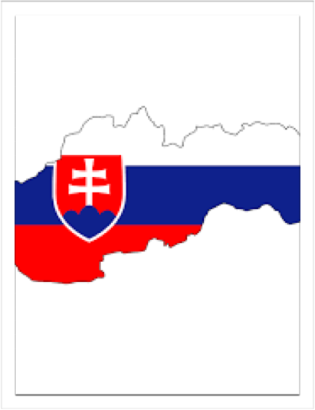
History of Slovakia
1918 - 1989 Czechoslovakia (socialistic federation)
1989 - “Velvet” revolution
1993 - Czechoslovakia was split into 2 independent states Czech Republic and Slovak Republic
2004 - membership in the European Union

