Slide 1
Lawmaking
Miroslava Vozáryová
Comenius University Bratislava, MFA SR

Slide 2

Authorities with the power to adopt legal acts
National Council of the Slovak Republic (Parliament)
Government of the Slovak Republic
Ministries and other central government bodies
Municipal and city authorities
Citizens (voters) of the Slovak Republic
Residents of a municipality or city

Slide 3
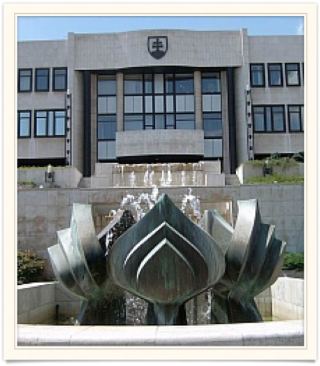
National council of the Slovak republic
Constitution
Constitutional acts
Acts
International Treaties

Slide 4
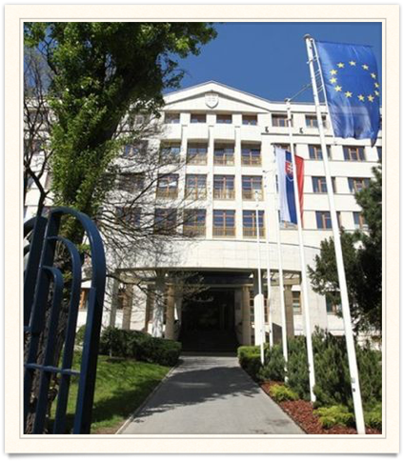
Ministries and other central government bodies
Decrees
Declarations
Measures

Slide 5
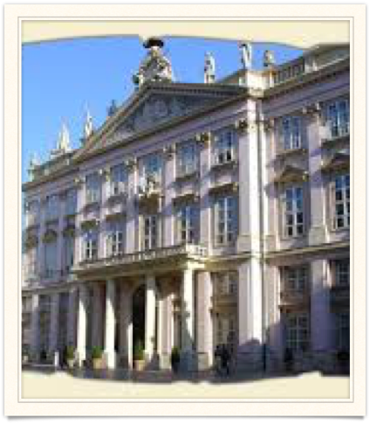
Municipal and city authorities
Generally binding regulations

Slide 6
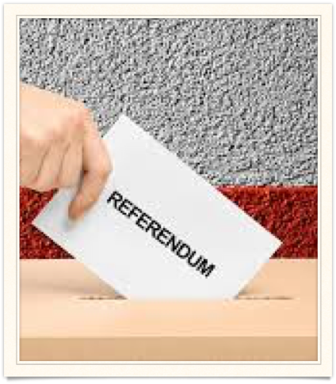
citizens (voters) of the Slovak republic
Results of a referendum with the force of constitutional act, results of a referendum with the force of an act

Slide 7
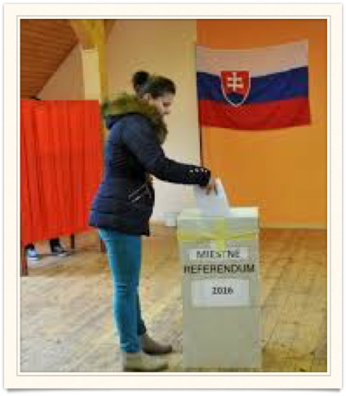
residents of a municipality or city
Results of a local referendum with the force of a generally binding regulation

Slide 8

the stages of the legislative process
Tabling of a bill - initiation
Discussion of the bill
Voting (decision on the bill)
Signing of the adopted bill
Promulgation (publication)

Slide 9
Initiation of legislation
Committees of the National Council of the Slovak Republic (Parliament)
members of the Parliament
the Government of the Slovak Republic

Slide 10
Discussion of the bill
Interdepartmental comments procedure
  Normal delay 15 calendar days/shortened delay 7 calendar days
  Compulsory commentators
  public comments (at least 500 persons)

Slide 11
discussion of the bill
comments (general, particular, material, legal, legislative-technical, technical, linguistic)
  Essential - dispute settling procedure
  Ordinary

Slide 12
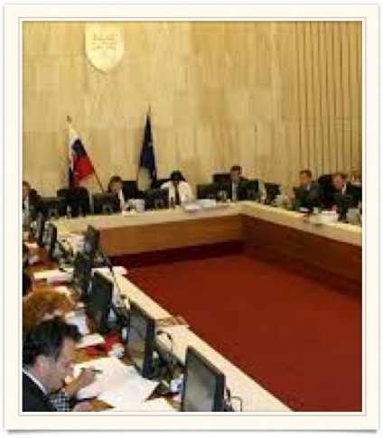
governmental session
Legislative Council of the Government
Adoption by the Government

Slide 13
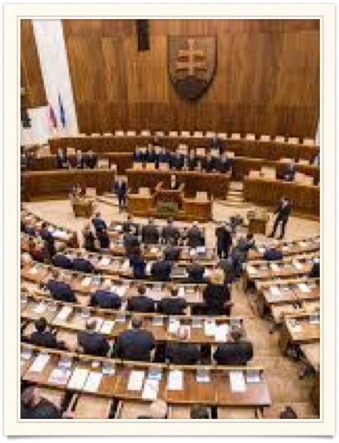
legislative process in the parliament
First reading
Second reading
Third reading

Slide 14
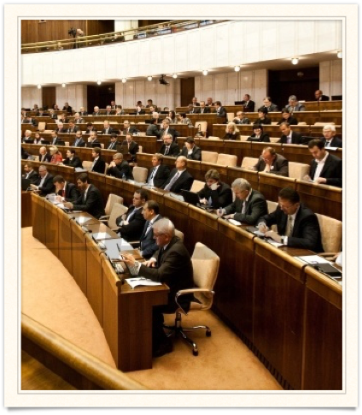
The first reading
general debate on the substance/philosophy of the proposed act
Determination of the Coordination committee and commitees in the second reading

Slide 15
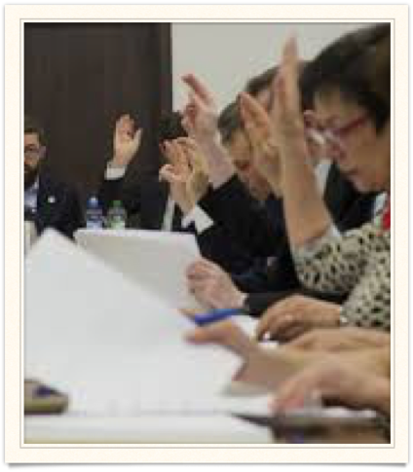
the second reading
the proposed act is discussed in committees - responsible is the determined Coordination committee
Amendments and additions can be tabled
the role of Coordination committee

Slide 16
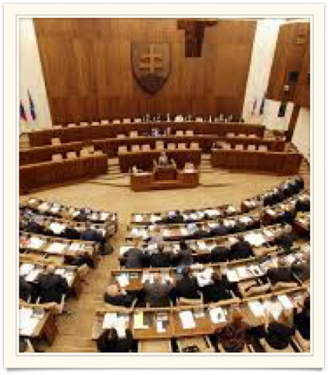
the third committee
final voting
only technical amendments are permitted

Slide 17
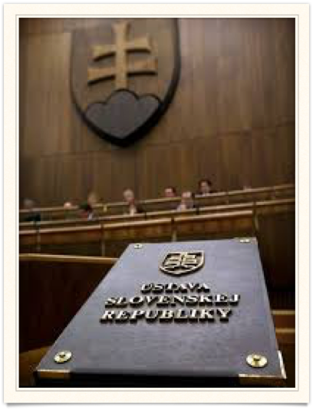
voting of the bill
constitution - qualified majority (three-fifths of all MPs)
Law - half of the present members

Slide 18
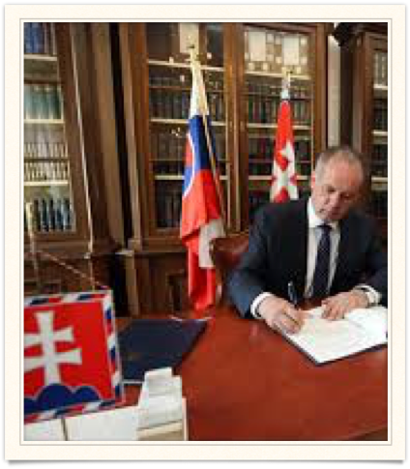
Signing
President of the Slovak Republic (suspensive veto)
the Speaker of the Parliament
the Prime Minister

Slide 19

Promulgation
Collection of Laws of the Slovak Republic
on-line system Slov-Lex (EU funds)

Slide 20
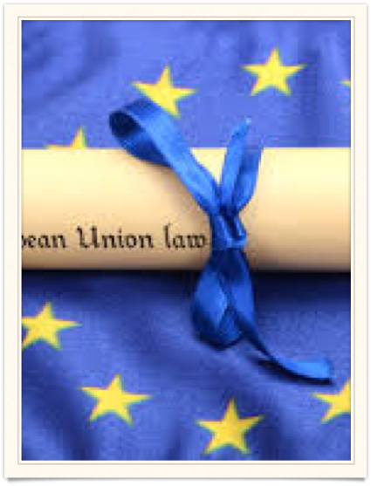
Approximation of eu laws
Regulation
Directive
Decisions
Recommendations
Opinions

Slide 21

what is regulated by eu laws
Judicial cooperation in civil matters (recognition of judgements, judicial assistance)
Police cooperation
Foreign policy
Agriculture
Foreign investments

Slide 22
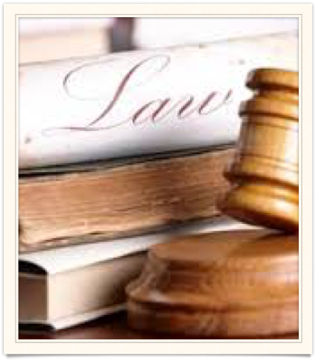
what is not regulated by eu laws
Taxes
Local payments
Administrative law/procedure
Civil law (legal capacity, legal entities, contractual law, inheritance, recovery of damages)
Criminal law
Trade law

Slide 23

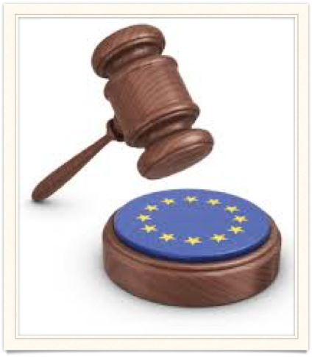
Regulation
A "regulation" is a binding legislative act. It must be applied in its entirety across the EU. For example, when the EU wanted to make sure that there are common safeguards on goods imported from outside the EU, the Council adopted a regulation.

Slide 24
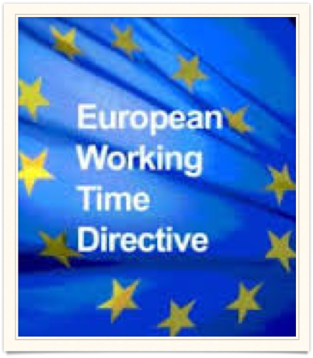

Directive
A "directive" is a legislative act that sets out a goal that all EU countries must achieve. However, it is up to the individual countries to devise their own laws on how to reach these goals. One example is the EU consumer rights directive, which strengthens rights for consumers across the EU, for example by eliminating hidden charges and costs on the internet, and extending the period under which consumers can withdraw from a sales contract.

Slide 25

Decision
A “decision” is binding on those to whom it is addressed (e.g. an EU country or an individual company) and is directly binding.

Slide 26
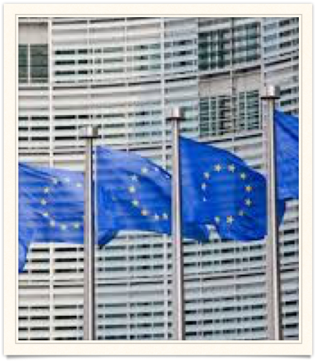
Recommendation
A “recommendation” is not binding. Allow institution to make their views known without imposing any legal obligation.
is

Slide 27
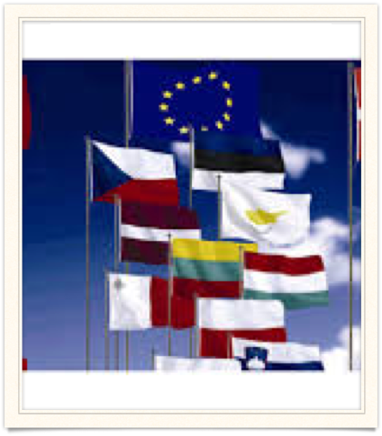
Opinion
An "opinion" is an instrument that allows the institutions to make a statement in a non-binding fashion, in other words without imposing any legal obligation on those to whom it is addressed. An opinion is not binding.

Slide 28
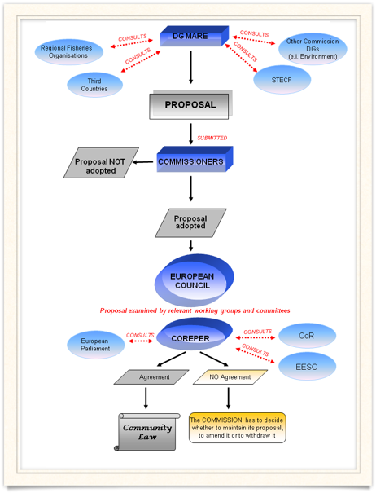
Legislative process within the eu
Working groups
Committees
eu council
eu parliament
Publication in the official journal of the European Union

